Slide 1
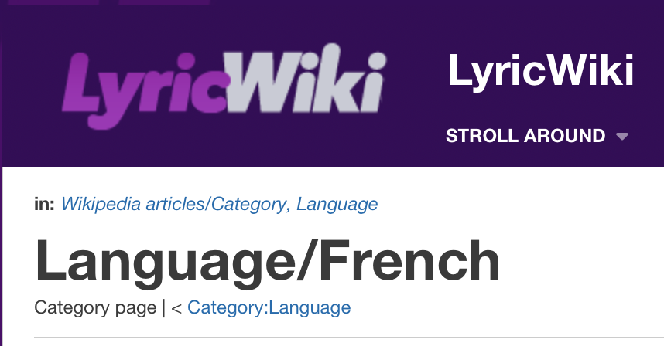

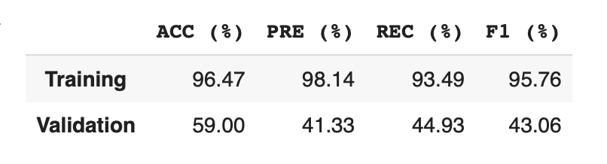
CLASSIFICATION OF NON-ENGLISH SONGS BASED ON LYRICS
Data collection and Pre-Processing
Model Creation and Classification
Results
French:
Growing demand for Music classifiers. Many classifiers exist for English songs but limited for other languages due to lack of data and proper language specific NLP techniques.
Training set: 151 happy, 249 sad
Validation Set: 78 happy, 122 sad
Vector Representations
Transforms text to feature vectors that can be used as input to estimator. TF-IDF is the numerical statistic intended to reflect importance of word.
Simple way to both tokenize a collection of text documents and build a vocabulary of known words, but also encode new documents using that vocabulary
With Beautiful Soup
Count Vectorizer
TF-IDF
Italian:
Lyrics Dataset
French
Italian
Spanish
Many classifiers are based on Audio type and beats of songs. But in some songs the tempo of the song can contradict or mask the actual essence of the song. Hence, we use lyrics to classify the songs.
Training set: 226 happy, 374 sad
Validation Set:21 happy, 39 sad
Naïve Bayes
Made By: Aarju Goyal, Md Shadman Rafid, Pruthvi Gollahalli Niranjana, Swati Mutyala
PRE-PROCESSING STEPS
Count Vectorizer
+ Multinomial
TF-IDF + Multinomial
Spanish:
Stop Word removal
Training set: 169 happy, 228 sad
Validation Set: 69 happy, 131 sad
Snowball is a small string processing language designed for creating stemming algorithms for use in Information Retrieval. Each language uses a different stemmer.
Count Vectorizer + Bernoulli
TF-IDF + Bernoulli
In Multinomial Naive Bayes, feature vectors represent the frequencies with which certain events have been generated by a multinomial distribution which can easily be turned into counts, such as word counts in text.
In Bernoulli Naïve Bayes event model, features are independent Booleans (binary variables) describing inputs where binary term occurrence features are used rather than term frequencies.
Tokenization
Conclusion : Of the four techniques : Count Vectorizer + Multinomial NB performed the best. Manual labelling for training and validation sets gave better results.
Snowball Stemming
Reference: Patra, Braja Gopal, Dipankar Das, and Sivaji Bandyopadhyay. "Retrieving similar lyrics for music recommendation system." Proceedings of the 14th International Conference on Natural Language Processing (ICON-2017). 2017.
Notes:
Deifnition of F1.
in searches of information retrieval, text mining, and user modeling

